Slide 1
iGaming
Technology
Provider
Customized and Agile iGaming Solutions for your unique business needs

Slide 2
About Us
A part of Sygnisoft Group
At BetWinSoft, we specialize in delivering customized iGaming solutions to empower companies with a competitive edge. With over 10 years of experience in the industry, we have built and operated successful online casinos in international markets, adhering to diverse regulatory frameworks. Our expertise also extends to the development of lottery systems.
With a team of over 30 skilled professionals, including analysts, developers, and managers, we leverage our 25 years of software development expertise to meet your unique needs.
betwinsoft.com

Slide 3
Our Casino Platform
Modern and flexible Online Casino Platform adjusted to big operators who expect dedicated solutions and 360 approach.
Flexible
Open for modifications to adapt your specific business requirements
Efficient and Secure
Built with the newest technologies and architecture trends, scalable and secure. Cloud based, microservices architecture
Powerful Back Office Advanced Players Management, Bonuses & Free Spins Management, Responsible Gaming, AML & AntiFraud modules, KYC support, Games Management, Integrations with Game Providers & PSPs, and more…
betwinsoft.com

Slide 4
Regulator Reporting System
Customer Support (CS) Solutions
Flexible Payment Solutions
Business Reporting System
Comprehensive
iGaming Solutions
KYC Reporting System
Advanced System for Rules
Flexible Game Hub
Financials Reporting System
betwinsoft.com
AML Reporting System
Marketing Activities Tools
Advanced Bonus System
VIP Panel
Integration with External Registration Solutions
Easy License Adoption

Slide 5
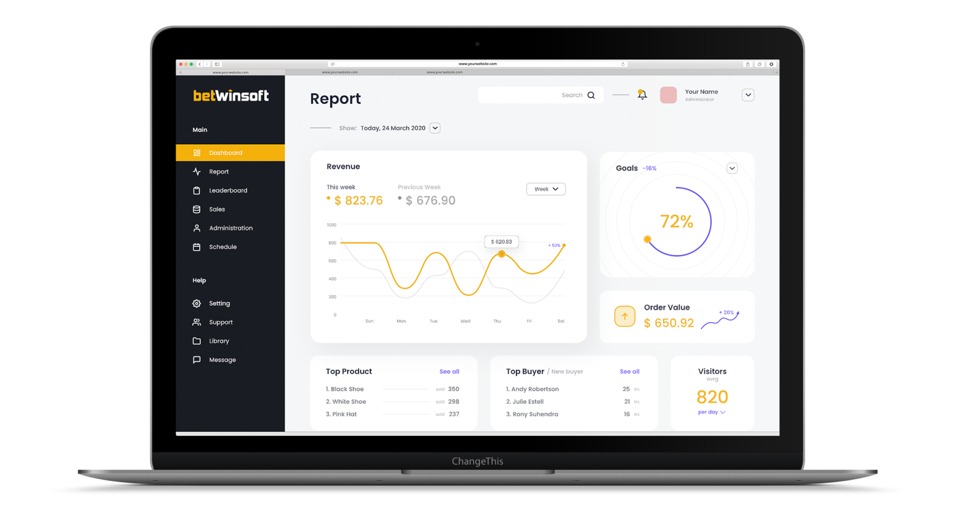
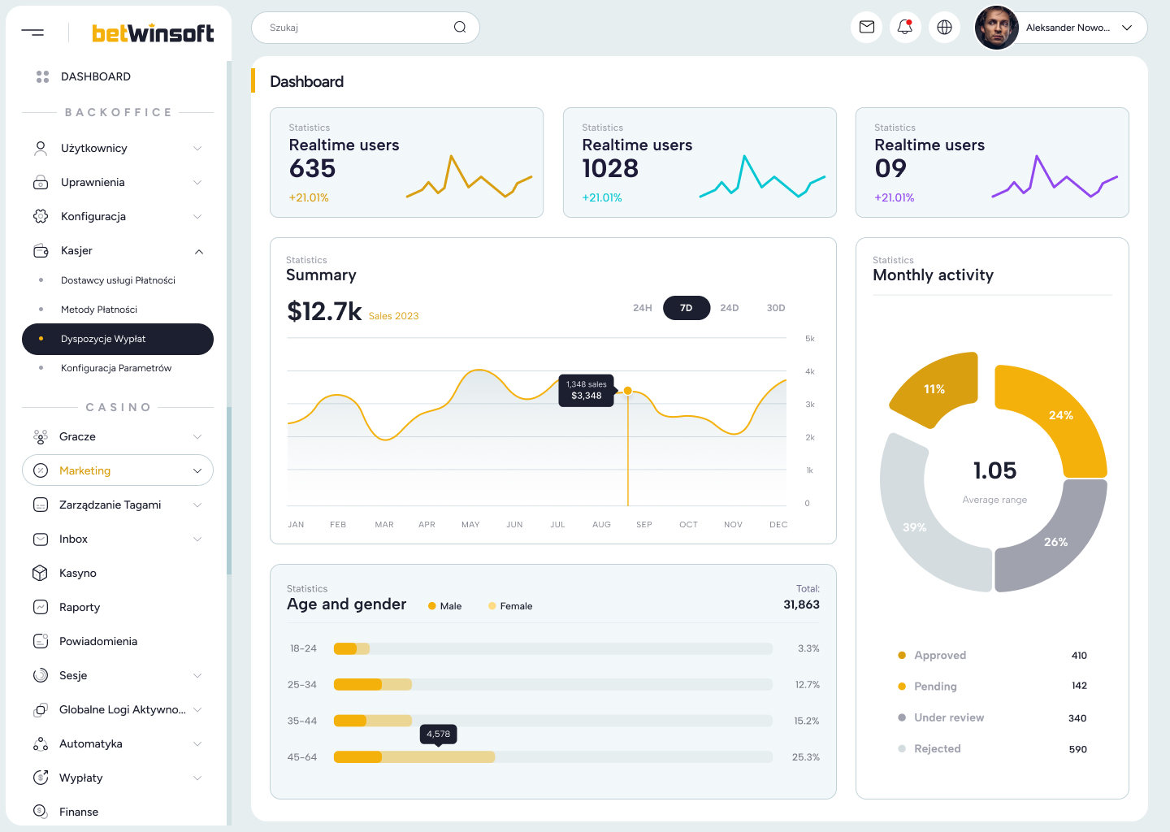
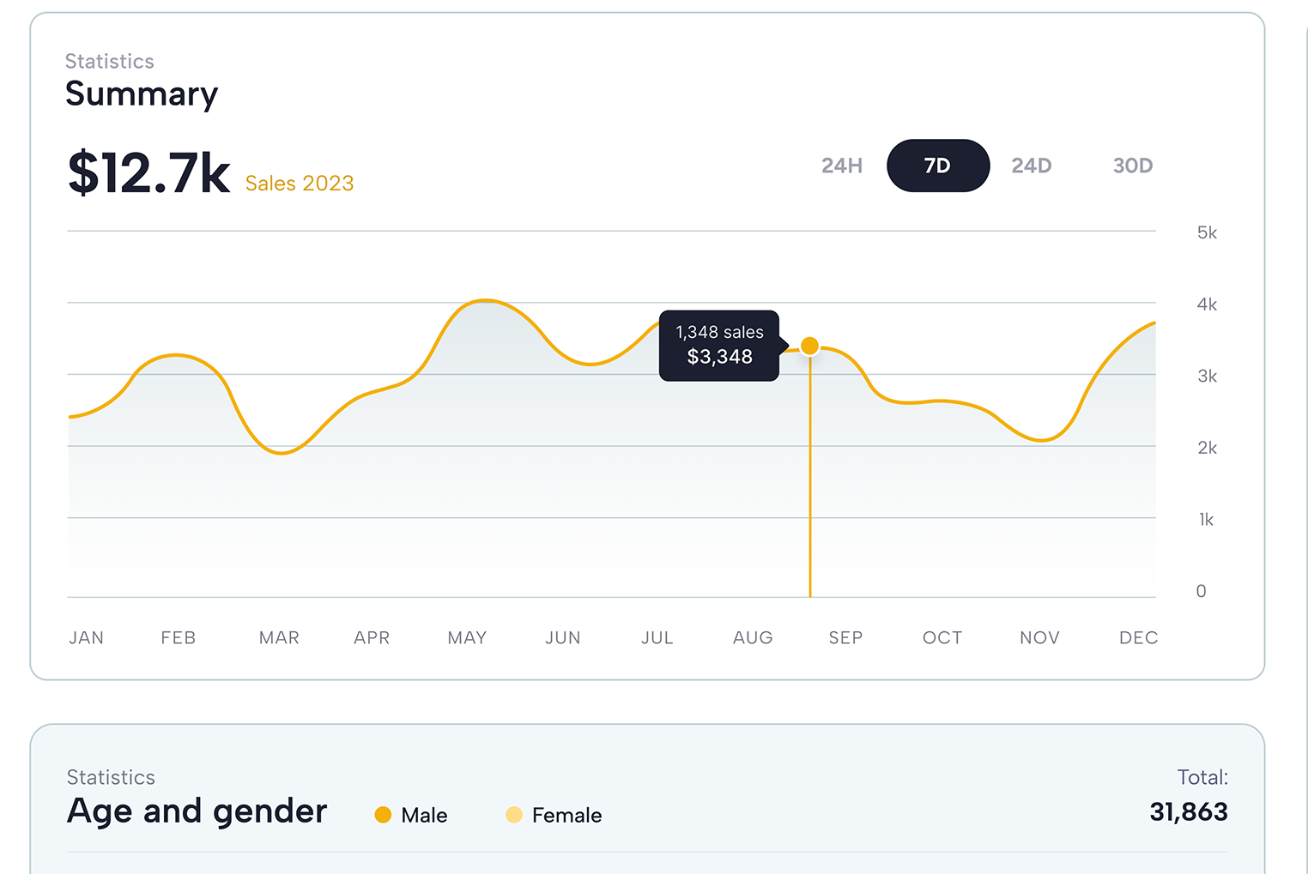
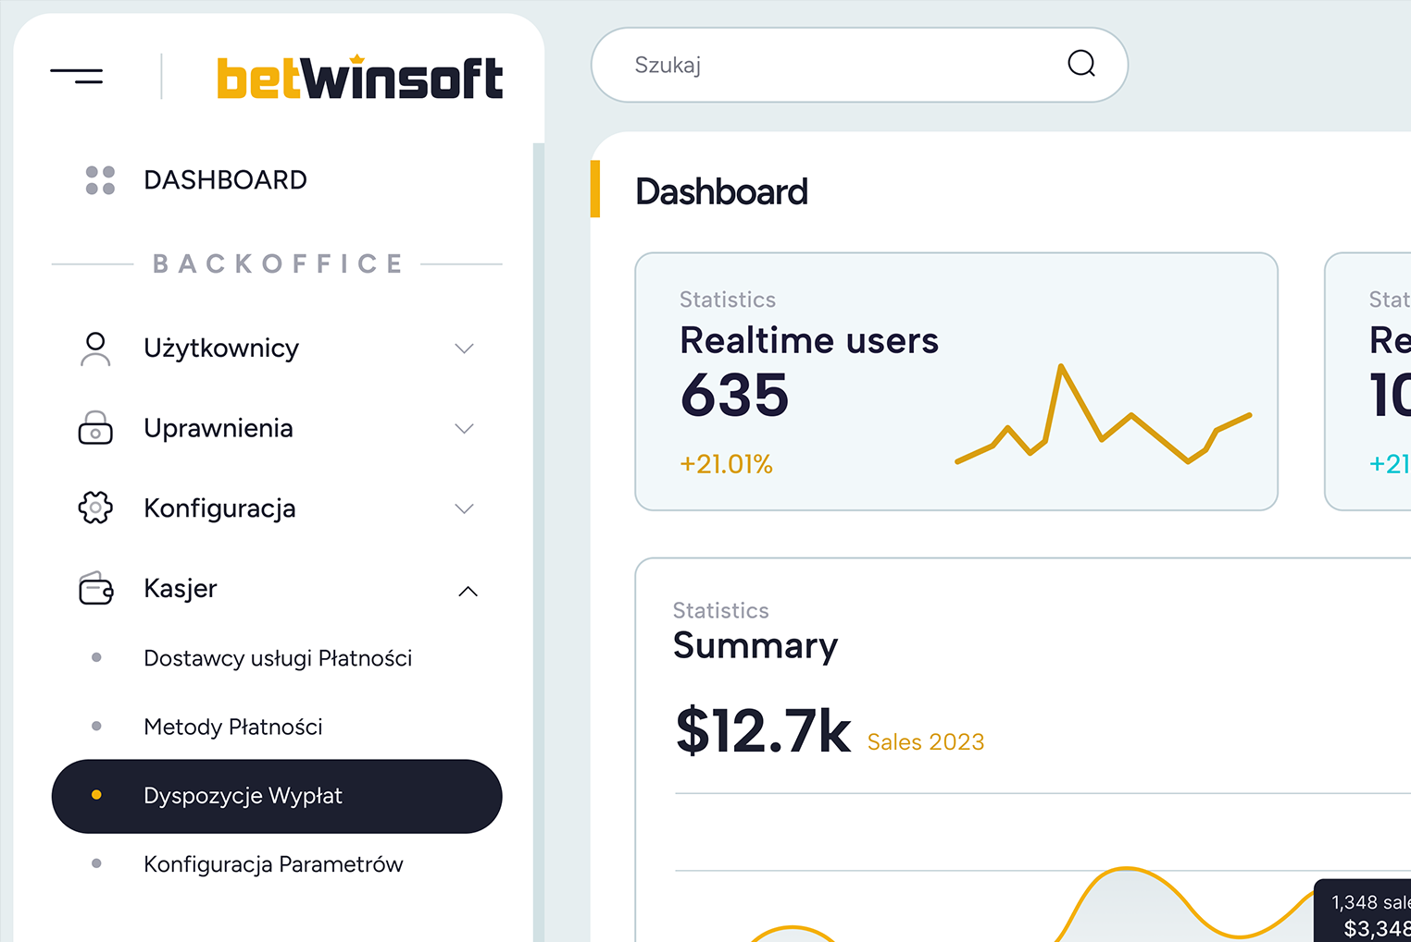
Our Casino Platform
Reporting System:
Our iGaming platform features a robust reporting system that provides real-time insights into revenue, transactions, and financial performance, helping operators make informed business decisions.
KYC Reporting System:
Know Your Customer (KYC) system streamlines the verification process, ensuring that all players are properly identified, reducing fraud risk, and maintaining compliance with regulations.
AML Reporting System:
Anti-Money Laundering (AML) rules help operators detect and report suspicious activities, ensuring compliance with AML regulations and preventing illicit financial transactions within the platform.
betwinsoft.com

Slide 6
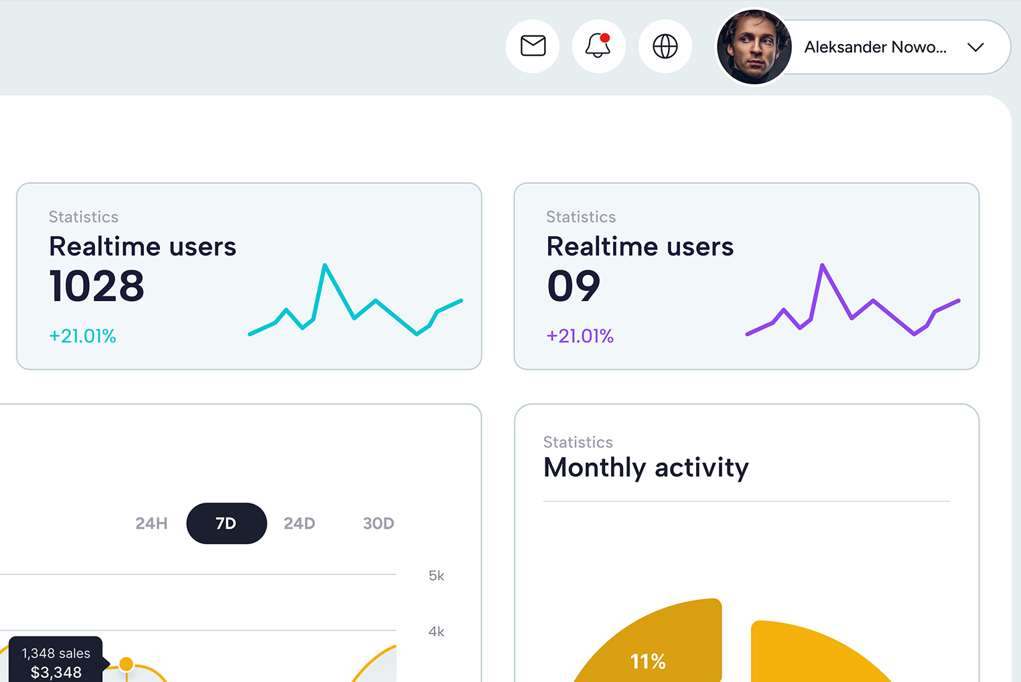
Our Casino Platform
Marketing Activities Tools:
Access a comprehensive suite of marketing tools to create and manage campaigns, promotions, and player engagement strategies effectively, helping to attract and retain players.
Regulator Reporting System:
Stay compliant with regulatory requirements by utilizing our reporting system, which generates the necessary reports and data needed for submission to relevant gaming authorities.
Business Reporting System:
Gain deep insights into your iGaming business with our reporting system, providing data on player behavior, revenue trends, and performance metrics, aiding in strategic planning.
Advanced System for Rules:
Customize and implement intricate gaming rules, ensuring a unique and tailored gaming experience for players while maintaining fairness and integrity.
betwinsoft.com

Slide 7
Our Casino Platform
Customer Support (CS) Solutions:
Provide top-notch customer support with integrated solutions, including live chat, ticketing systems, and knowledge bases, enhancing player satisfaction and loyalty.
Flexible Payment Solutions:
Our platform offers a variety of payment options, allowing players to deposit and withdraw funds using their preferred methods, enhancing convenience and accessibility.
Flexible Game Hub:
Access a diverse game library and seamlessly integrate new games from multiple providers, providing players with an ever-expanding selection of gaming options.
betwinsoft.com

Slide 8
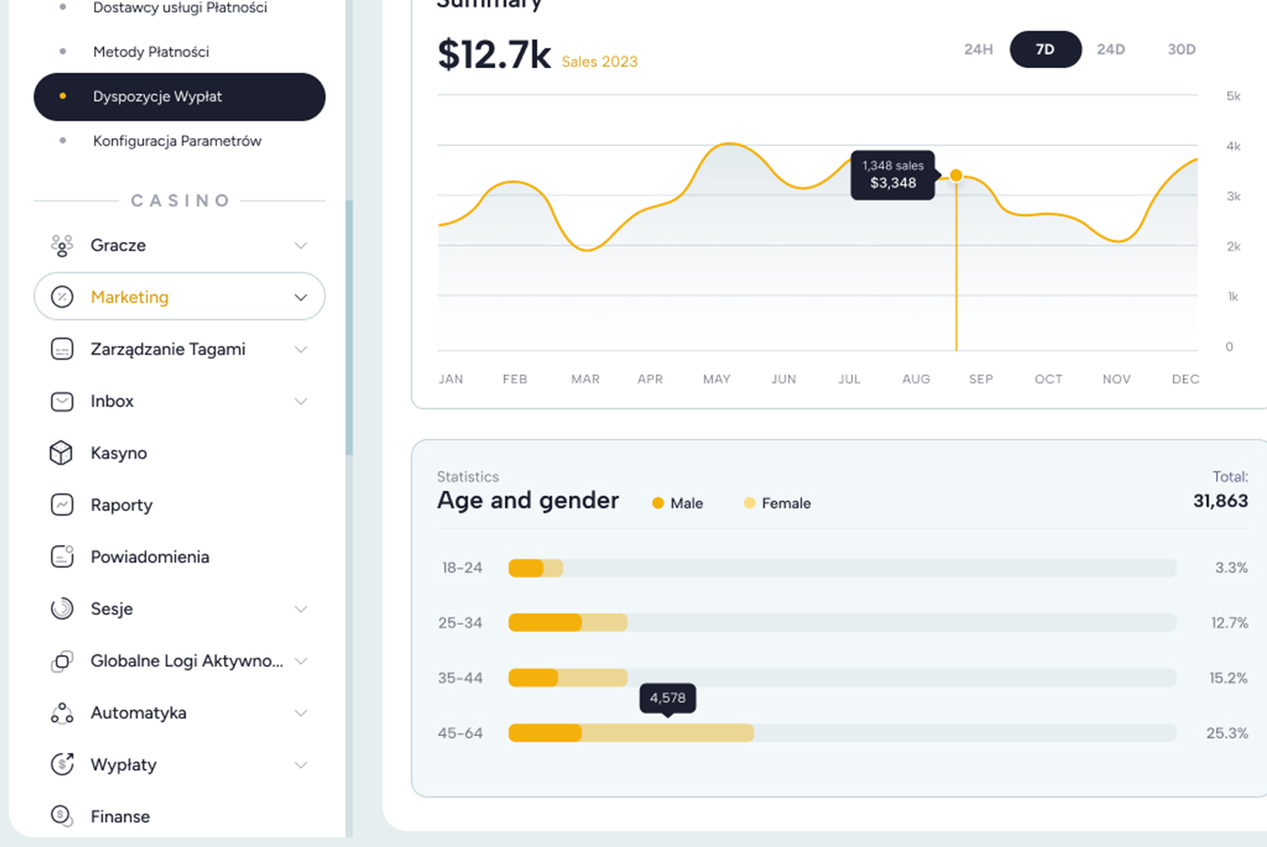
Our Casino Platform
Easy License Adoption:
Simplify the licensing process with our platform, making it easy for operators to acquire and manage the necessary licenses to operate legally.
Integration with External Registration Solutions:
Seamlessly integrate external registration and authentication solutions, enhancing user convenience and speeding up the registration process.
Advanced Bonus System:
Create and manage a sophisticated bonus system, offering various promotions, loyalty rewards, and incentives to attract and retain players.
Open Architecture:
Our platform features an open architecture, allowing for easy integration with third-party software, APIs, and other tools, enabling customization and scalability.
betwinsoft.com

Slide 9
Our Experience - online casino and sports betting
Implementation, launch and business management of sports betting and online casinos.
Brand creation
UX and UI design
Monitoring of performance, scaling, and adaptation of the platform
Daily management of acquisition, retention, and reactivation
Integration of payment and gaming gateways
Integration with mailing systems, chat, and customer service system
Expansion of the middle layer for greater flexibility in platform management
Creation of a risk management tool for the trading department
Implementation of gamification and loyalty programs
Customer Service 24/7
AML and KYC support
Affiliate activities
Creating marketing and promotional materials, including TV advertising spots
Compliance with the requirements of many regulators (MGA, UK Gambling Commission, and more)
betwinsoft.com

Slide 10
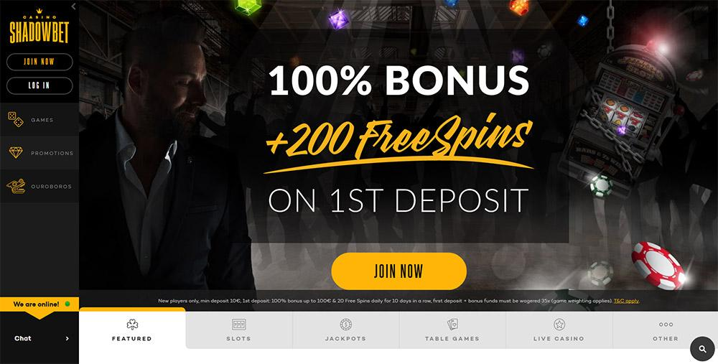
Our Experience - online casino and sports betting
betwinsoft.com
Best casino debut

Slide 11
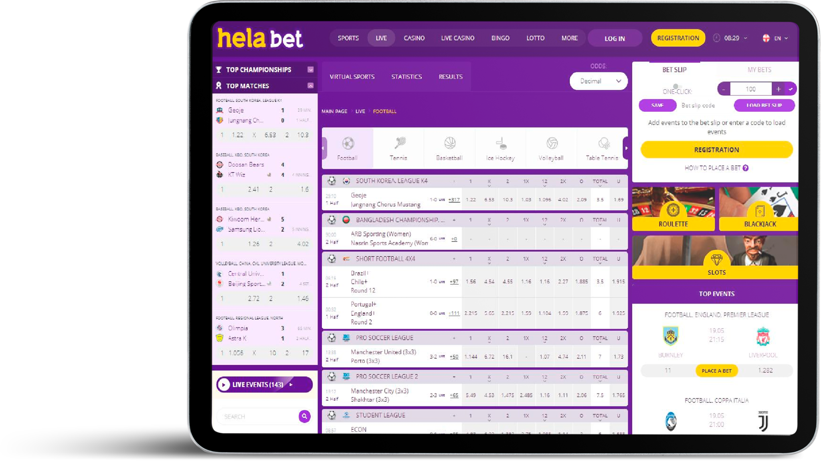
Our Experience - online casino and sports betting
betwinsoft.com
Mr Suppa
Helabet

Slide 12
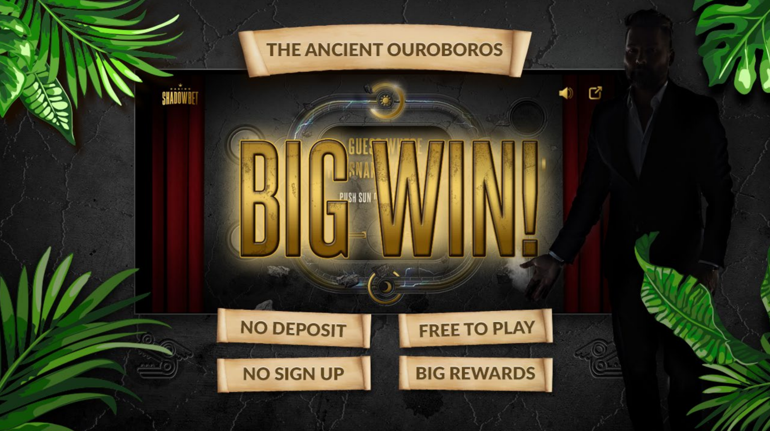
Our Experience - 360 casino player booster system
Ouroboros dedicated game
case study
We created an innovative strategy for building loyalty and commitment throughout the customer's life. Through their activity in the casino, players could play the game in which, depending on the frequency and style of play, they could win prizes tailored to their profile.
betwinsoft.com

Slide 13
Our Experience - 360 casino player booster system
Ouroboros dedicated game case study
Acquisition
To encourage people to visit the casino, the player could play the game even on an external partner's website before registration, free of charge. If lucky, he could win a guaranteed or consolation prize that he could collect after registering in the casino.
Retention
The Ouroboros game accompanied the player throughout his entire life cycle and playing in the casino. For their activity, players received points that allowed them to play the promotional Ouroboros game, in which they could win additional prizes. Players decide how many points to spend on the game. Players also received rewards on the Ouroboros game related to birthdays, Valentine's Day, or other events organized in the casino. The Ouroboros game was the central promotional mechanism throughout the casino.
Reactivation
The game was ideal for conducting reactivation activities. Thanks to the wide range of prizes in the game, the casino operator could send a dedicated and sufficiently attractive offer for reinstatement based on the previous game. The points-collecting mechanism and progressive multipliers also made players see more sense in staying with a given operator. Additionally, after a long absence, players received information that they might lose the points.
betwinsoft.com

Slide 14
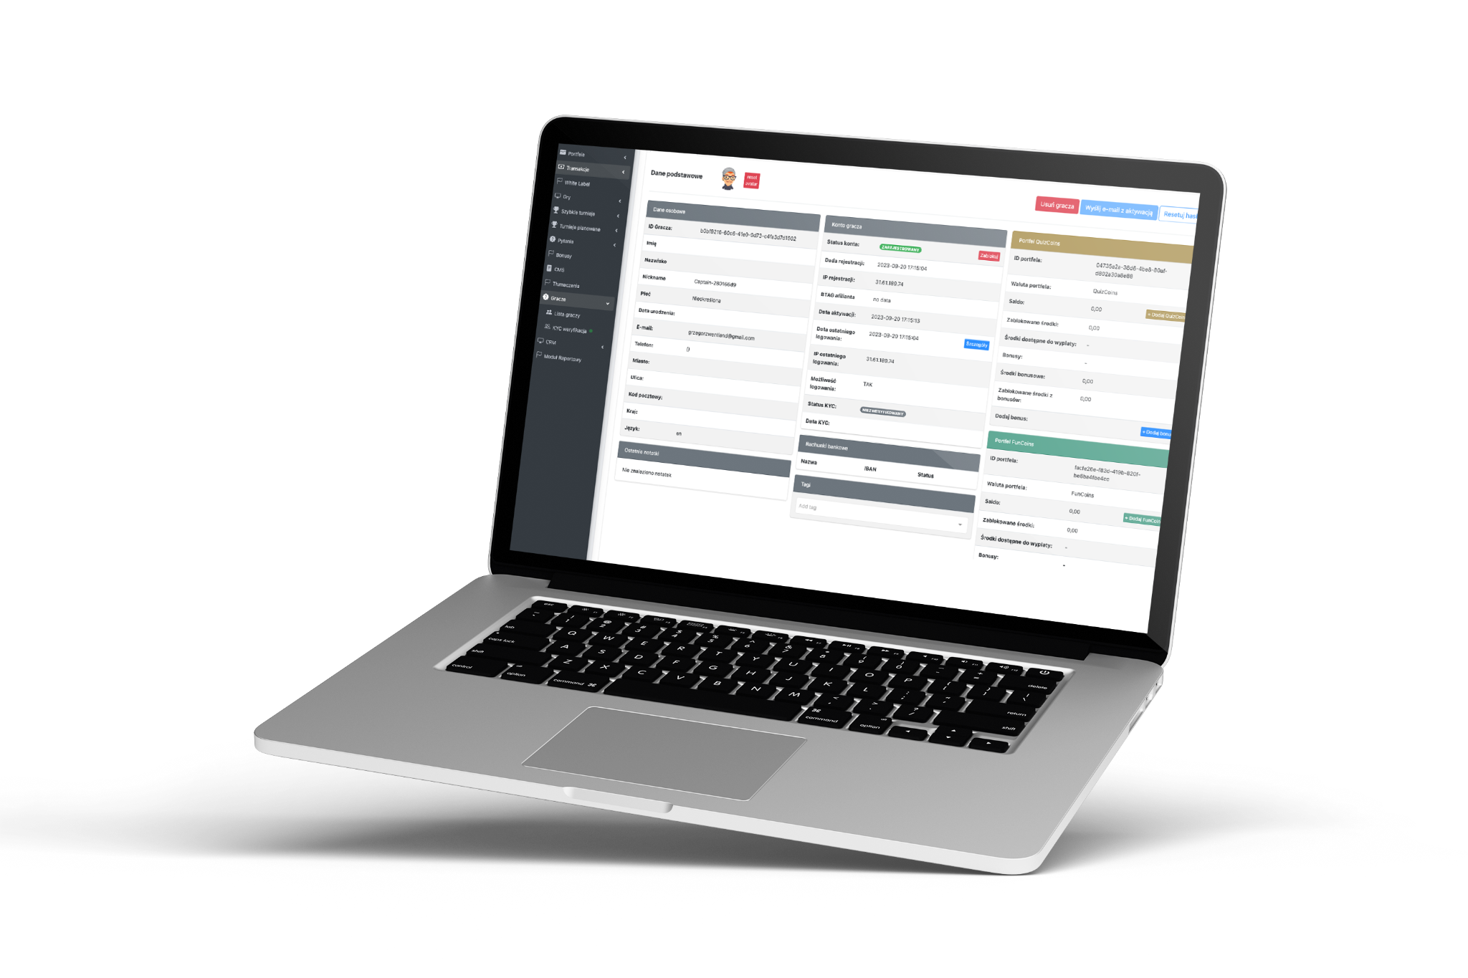
Our Experience - retention system
We have created an iGaming player retention tool that extends casino platform possibilities in marketing actions to increase player retention and engagement by offering unique and interactive promotion models.
Our tool is an intermediate layer between the frontend and backend, which builds customized promotions and marketing automation.
Software for the casino platform in the “On-Top” architecture
Extension of the platform increasing the flexibility of marketing activities
Real-time interactive promotions in multiplayer mode, with different types of rewards - free spins, bonus money, real money.
betwinsoft.com

Slide 15
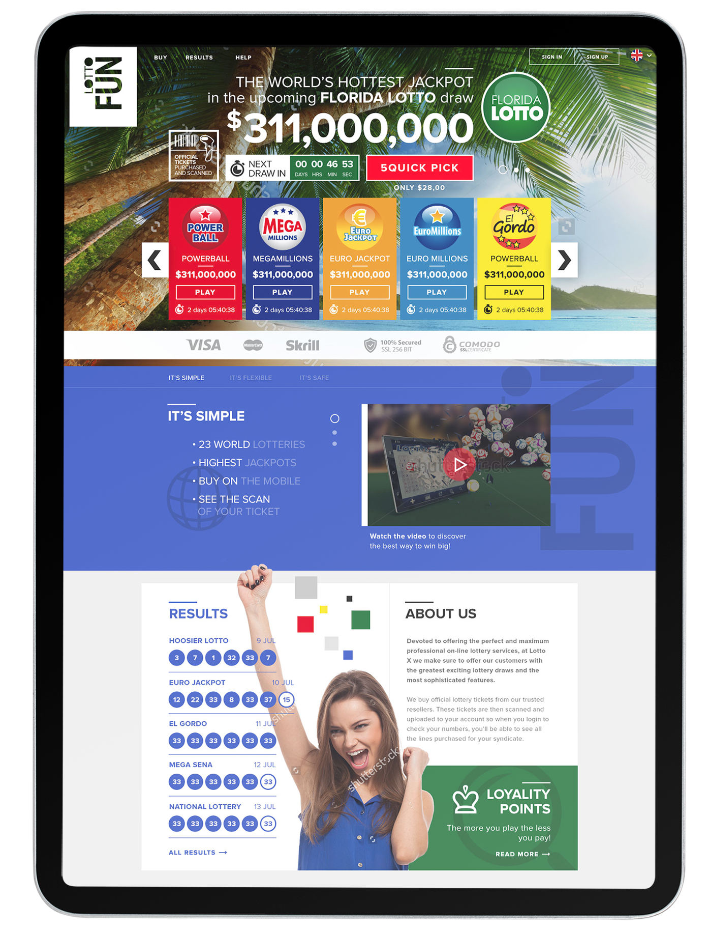
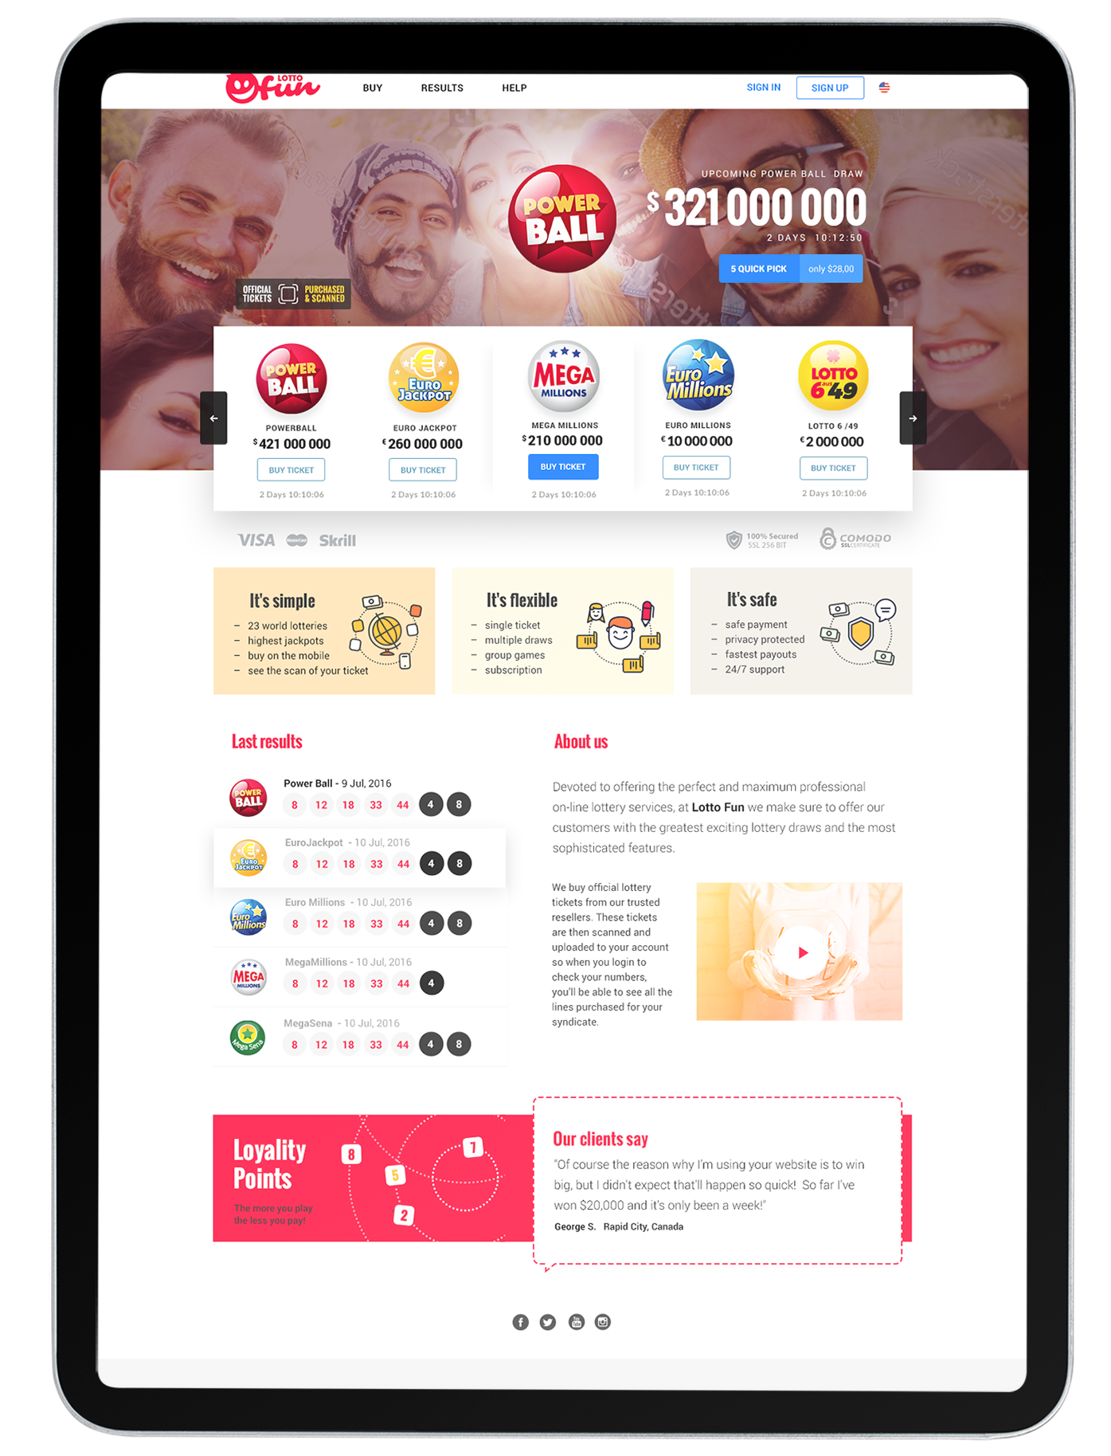
Our Experience - Lottery tech
We have created a platform for conducting lottery games, operating in 2 models:
Commission model - involves accepting coupons with numbers selected by the player, and then the agents purchase them on behalf of customers.
Insurance model - depending on the jackpot amount and other variables selected by the operator, it is possible to decide whether to insure a given coupon or send it to the lottery organizer.
The platform operated under a Curaçao license, meeting all licensing requirements regarding KYC, AML, and reporting to the regulator. The platform allowed several activities related to acquisition, retention, and reactivation, and it was compliant with the requirements of individual markets and operators.
Having CMS and CRM systems allowed it to freely conduct marketing activities at every stage of the customer life cycle. Integration with payment systems, external email marketing tools, and social media operators was also possible.
betwinsoft.com

Slide 16
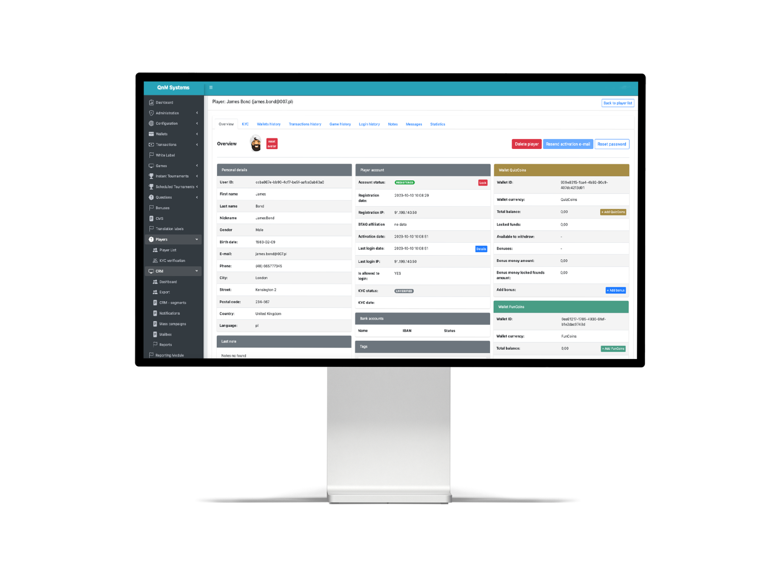
Our Experience - skill based games
platform
We have created a quiz platform where players can compete with each other and win real money and in-kind prizes using their knowledge and skills. The potential services market is unlimited, and quizzing can be daily entertainment for any audience. The rules are simple and based on well-known game shows, which are popular in every corner of the world.
All must-have features included real-time push driven data events using WebSockets to increase gamification and engagement, award-winning tournaments, ready-to-implement payment provider integrations that support credit and debit cards, and many more.
betwinsoft.com

Slide 17
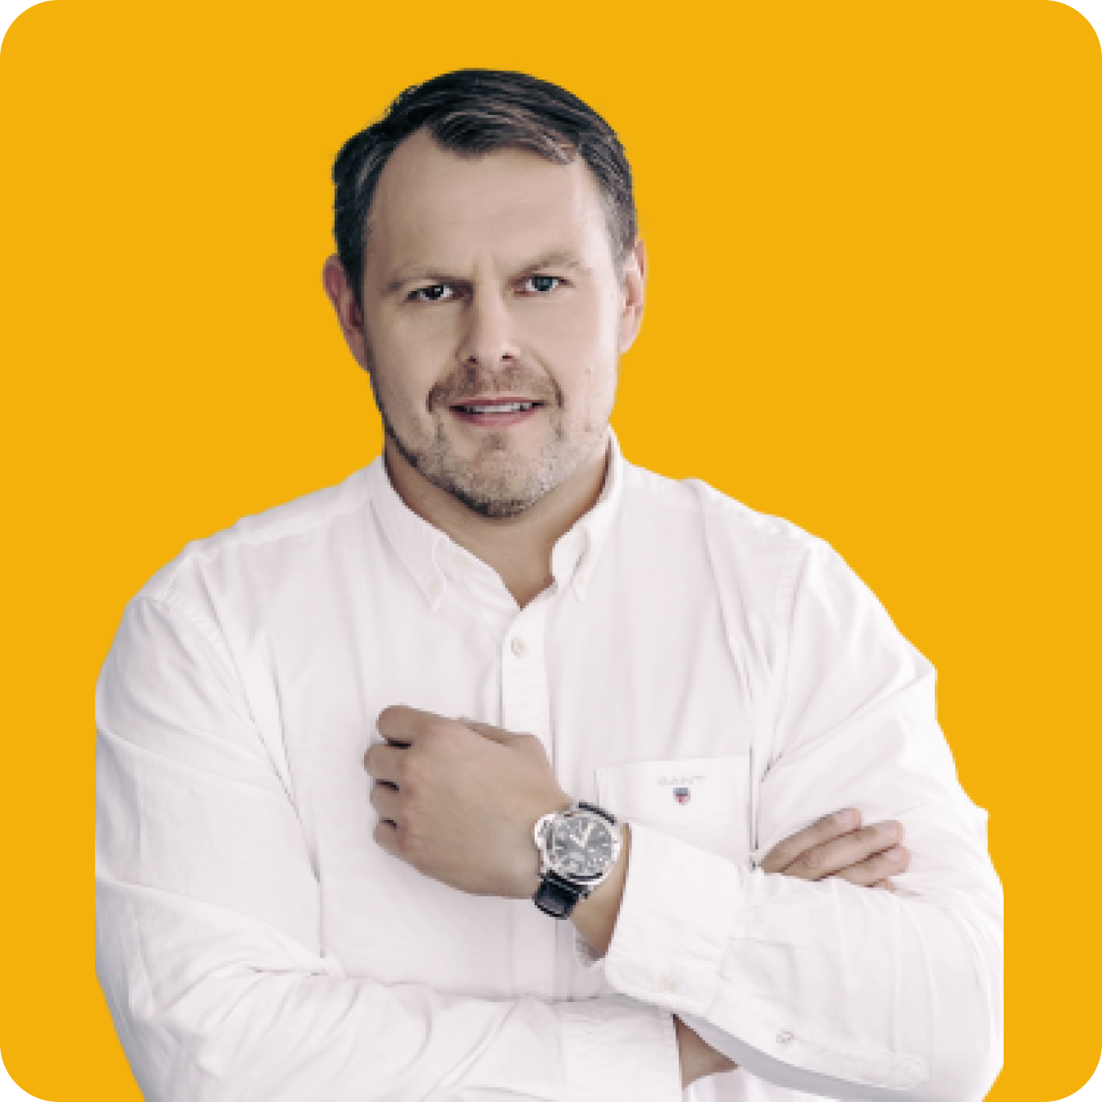
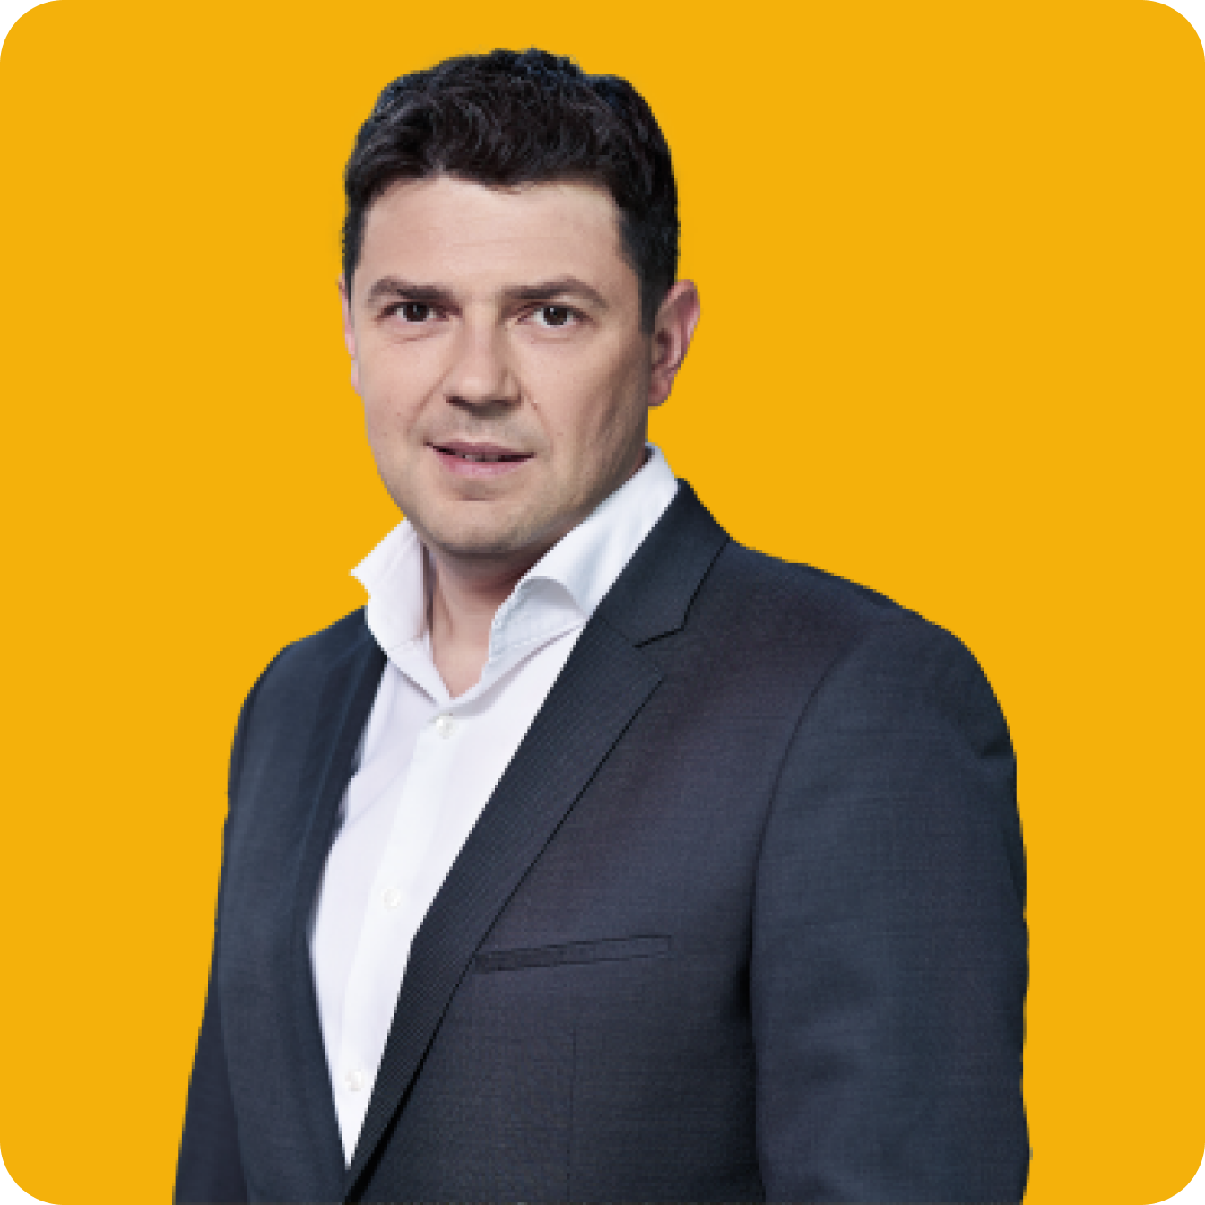
Experienced Team
10+ years of experience
in the iGaming business
25+ years of experience
in a Software Development
and Project Management
Tomasz Szymański
Business Consultant
Rafał Wójcik
Product Owner
betwinsoft.com
Artur Różycki
Affiliate Manager
Paweł Kolanecki
Software Architect

Slide 18
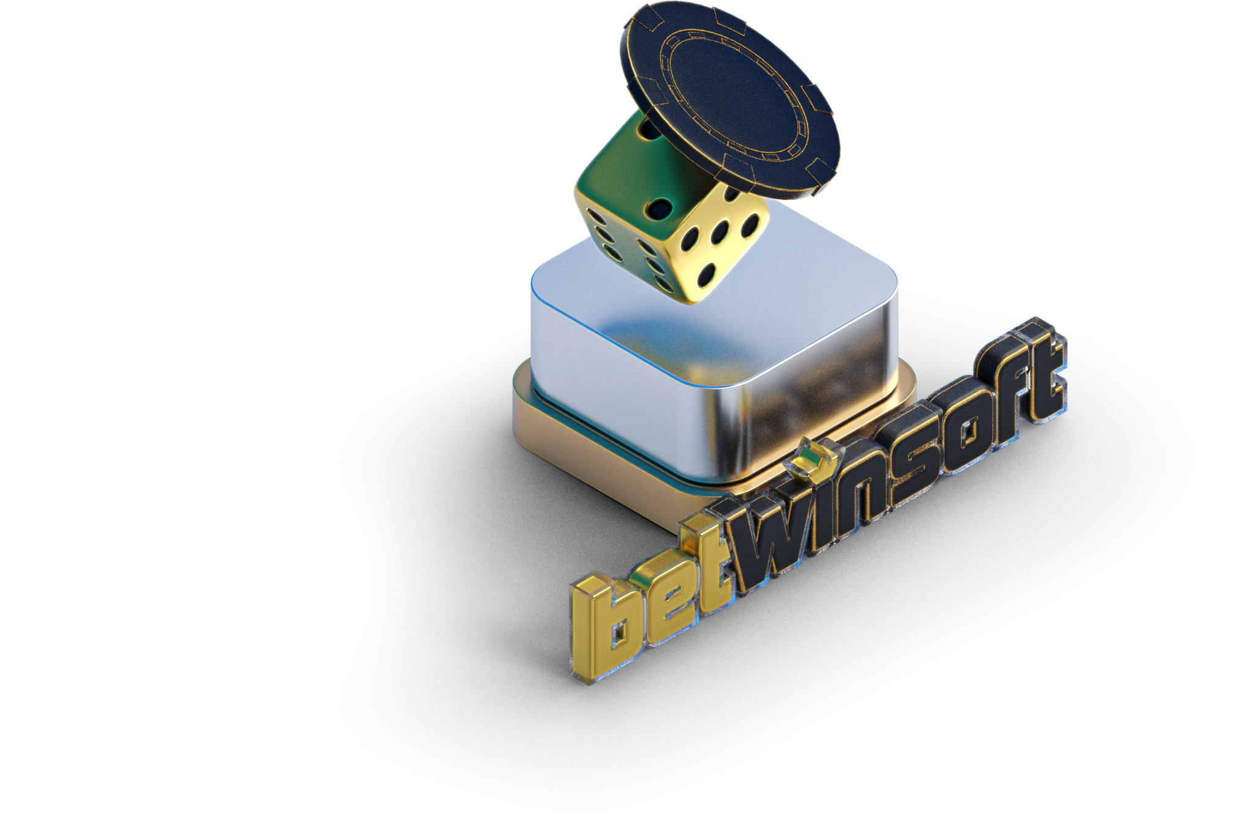
iGaming
Technology
Provider
Tomasz Szymański
Email: t.szymanski@sygnisoft.com
Tel.: +48 501 878 977
BetWinSoft
Sygnisoft SA
Grzybowska 2 Street,
00-131 Warsaw, Poland

